Slide 1


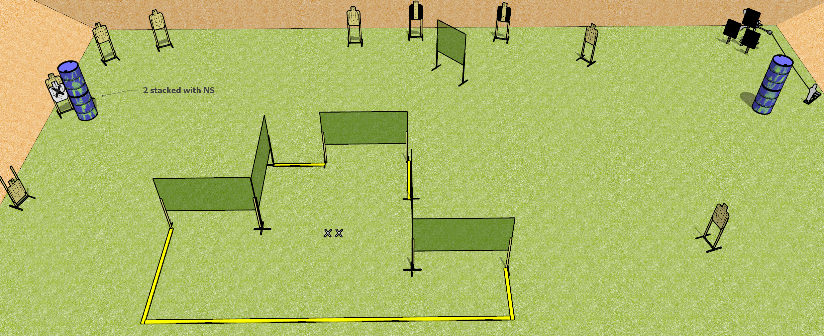
 | Dothan Gun Club – USPSA Match Get Stitches Course Designer : Drew Coleman
Round Count 25 rounds 11 USPSA targets 1 mini popper 2 falling plates
Equipment List 10 wall feet 1 mini popper Red stitch target 2-3 18x24 plates and target stands 3 medium fault lines

Slide 2
Get Stitches
Written Stage Briefing
Get Stitches is a 25 round, 125 point, Comstock field course. There are 11 USPSA targets, 2 falling plates, and 1 USPSA mini popper. The best 2 hits on paper will score, and steel must fall to score. The start signal is audible.
The swinging steel target is activated by the mini popper, and must be activated before being engaged. Please check the activator prior to walkthrough and set it the same way every time.
Handgun start position is both feet on X’s, wrists below belt. Handgun is loaded and holstered.
PCC start position is both feet on X’s. Loaded carbine is held with both hands, stock on belt, safety on.
On start signal, engage targets as they become available from within the shooting area.

